Slide 1
LOAD-BALANCING & AUTO SCALING ON AWS
Prashant Raj (C-71)
Pritesh Gaikwad (C-74)
Sarang Rajurkar (D-3)
Vivek Pundkar (C-77)
Pushkar Pawar (C-64)
Guide:
Prof. Vijay Mane SIR

Slide 2
LOAD BALANCING

Slide 3



What is load balancing?
Load balancers are servers that forward internet traffic to multiple servers (EC2 Instances) downstream.

Slide 4
Why to use load balancer?
Spread load across multiple downstream instances.
Expose a single point of access (DNS) to application.
Seamlessly handle failures of downstream instances.
Do regular health checks to your instances.
Provide SSL termination (HTTPS) for application
High availability across zone
Separate public traffic from private traffic.

Slide 5
AWS EC2 Load Balancer?
An ELB (EC2 Load Balancer) is a managed load balancer
AWS guarantees that it will be working
AWS takes cars of upgrades, maintenance, high availability
AWS provides only a few configuration knobs
It is integrated with many AWS offerings/services

Slide 6
Health Checks?
Health Checks are crucial for Load Balancers
They enable the load balancer to know if instances it forwards traffic to are available to reply for requests
The health check is done on a port and a route (/health is common)
If the response is not 200 (OK), then the instance is unhealthy
Health Checks
Port 80
Route /health

Slide 7
How To Create Load Balancer On AWS ?
Create Target Group
Choose Target Type (let’s say EC2 Instances)
Choose Protocol + Port
Choose Health Check Route
Create Load Balancer
Security Groups (Network inbound/outbound traffic)
Listeners and Routing
Register EC2 instances to target groups

Slide 8
Types of load balancer on AWS
1
2
3
Classic Load
Balancer
(V1-old generation) - 2009
Application Load Balancer
(V2-new generation) - 2016
Network Load Balancer
(V2-new generation) - 2017
Notes:
Overall it is recommended to use the newer v2 generation load balancers as they provide more features.

Slide 9
Classic load balancers allow to do:
Support for EC2-Classic
Support for TCP and SSL listeners
Support for sticky sessions using application-generated cookies
Deprecated and now often replaced with application load balancer.
1
Classic Load
Balancer
(V1-old generation) - 2009

Slide 10
Application load balancers allow to do:
Load balancing to multiple HTTP applications across machines (multiple instances)
Load balancing to multiple applications on same machines (ex: containerized applications)
Load balancing based on route in URL
Load balancing based on hostname in URL
They are really good for micro services & container based application
2
Application Load Balancer
(V2-new generation) - 2016

Slide 11
What Network Load Balancer Offers :
Fourth layer of the Open Systems Interconnection (OSI) model
Ability to handle volatile workloads and scale to millions of requests per second
Support for static IP addresses for the load balancer.
Support for monitoring the health of each service independently
Support for routing requests to multiple applications
3
Network Load Balancer
(V2-new generation) - 2017

Slide 12
AUTO-SCALING

Slide 13
What’s an Auto Scaling?
In cloud computing feature that enables organizations to scale cloud services such as server capacities or virtual machines up or down automatically
Benefits of Auto Scaling
Lower cost
Reliable performance
Ensure we have a min and max number of machines running
eliminates the need to respond manually

Slide 14
Key Terms
Scale Out
Achieving scalability by increasing the number of ec2 instances.
Scale In
Achieving scalability by decreasing the number oof ec2 instances.

Slide 15
Auto Scaling Group in AWS
Maximum Size
Actual Size / Desired Capacity
Scale Out As Needed
Minimum Size

Slide 16
ASG Attributes in AWS
A launch configuration
AMI + Instance Type
EC2 User Data
EBS Volumes
Security Groups
SSH Key Pair
Min / Max Size / Initial Capacity
Network + Subnets Information
Load Balancer Information
Scaling Policies
Notes:
Launch configuration include AMI(which server to deploy like the OS that it will have), Instance Type(server specification like its ram, rom, no of cpu and its network performance based on how big our application is) EBS volumes basically the storage that we will need, security groups(which determine the which traffic to allow on newly deployed server) and lastly the ssh key pair
Load balancer as it works very good with ASG we can register servers directly under loadbalancer using ASG
Lastly the scaling policies which will be discussed further by vivek

Slide 17
Scaling Plans
A scaling plan is the core component of AWS Auto Scaling. It's where you configure a set of instructions for scaling your resources.
Manual Scaling: Modify via API, Trigger, CLI, AWS Console
Scheduled Scaling: Based in Time Events
Dynamic Scaling: Scale on AWS CloudWatch Metrics

Slide 18
How scaling plans work
If one works with AWS CloudFormation or add tags to scalable resources, one can set up scaling plans for different sets of resources, per application.
AWS Auto Scaling provides recommendations for scaling strategies customized to each resource.
After creating your scaling plan, AWS Auto Scaling combines dynamic scaling and predictive scaling methods together to support your scaling strategy.

Slide 19
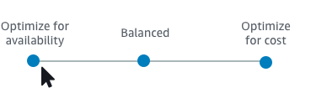
What is a scaling strategy?
The scaling strategy tells AWS Auto Scaling how to optimize the utilization of resources in your scaling plan.
One can optimize for availability, for cost, or a balance of both. Alternatively, you can also create your own custom strategy, per the metrics and thresholds you define.
One can set separate strategies for each resource or resource type.

Slide 20
Dynamic and Predictive scaling?
Dynamic scaling is a feature of auto scaling. That allows you to automatically scale the capacity of your group in response to changing demand. So we can configure scaling policies that track a specific metric. For example, CPU utilization.
Predictive scaling uses machine learning to analyze each resource's historical workload and regularly forecasts the future load for the next two days. This is similar to how weather forecasts work.

Slide 21
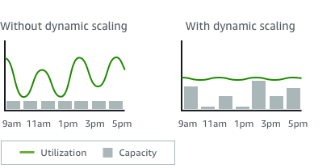
For example, you can configure your scaling plan to keep the number of tasks that your ECS service runs at 75 percent of CPU.
When the CPU utilization of your service rises above 75 percent (meaning that more than 75 percent of the CPU that is reserved for the service is being used), this triggers your scaling policy to add another task to your service to help out with the increased load.

Slide 22
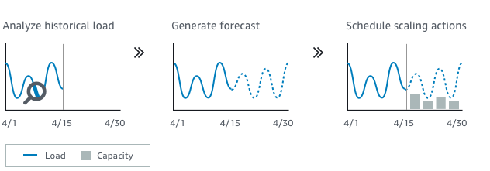
For example, you can enable predictive scaling and configure your scaling strategy to keep the average CPU utilization of your Auto Scaling group at 50 percent.
Your forecast calls for traffic spikes to occur every day at 8 o'clock in the morning.
Your scaling plan creates the future scheduled scaling actions to make sure that your Auto Scaling group is ready to handle that traffic ahead of time.
This helps keep the application performance constant, with the aim of always having the capacity required to maintain resource utilization as close to 50 percent as possible at all times.

Slide 23
Conclusion
Load Balancer allows
to reduce the load on your web servers and optimize traffic
it compress website traffic giving your users a much better experience with your website
Auto Scaling allows
saving electric costs for companies
it manages their own web server infrastructure.
also saves extra cost of server

Slide 24
References
Amazon Web Services Documentation
https://aws.amazon.com/elasticloadbalancing/
https://aws.amazon.com/about-aws/whats-new/2018/01/introducing-aws-auto-scaling/

Slide 25
Thank You

